Slide 1
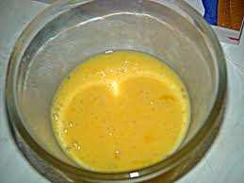
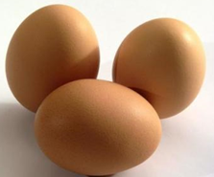
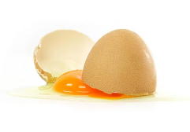
The Break-up and
Marriage activity
(Morphological Forced Connections)

Slide 2
How?
This is almost like an invention finding technique. It is a vehicle for you to advance on original designs come up with something new.
Three steps to follow:
Break up the design into different part and list them.
Below each part list as many alternates as you can.
Make random runs through the alternates selecting different ones each time (marry them together). You should end up with many solutions

Slide 3
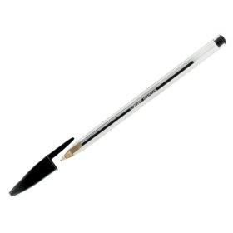
Lets start off with a simple problem for an example:
Problem: Improve on the ball-point pen

Slide 4
Step 1.
Break up the design into different parts and list them like so:
CASING | MATERIAL | CAP | INK SOURCE

Slide 5
Step 2
Below each part list as many alternates as you can!
CASING | MATERIAL | CAP | INK SOURCE
Faceted | Metal | Attached | Paper Cartridge (running ink)
Square/cube | Glass | No cap | Permanent
Irregular | Wood | Retractable | No Cartridge
Wavy | Plastic | Screw cap | Filled with ink
 | Paper

Slide 6
Step 3:
Make random runs through the alternates selecting different ones each time (marry them together). You should end up with many solutions
CASING | MATERIAL | CAP | INK SOURCE
Faceted | Metal | Attached | Paper Cartridge (running ink)
Square/cube | Glass | No cap | Permanent
Irregular | Wood | Retractable | No Cartridge
Wavy | Plastic | Screw cap | Filled with ink
 | Paper

Slide 7
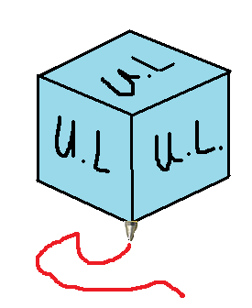
Example Solution!
An environmental wooden Cubic Pen with its ball point on one corner. This leaves 6 sides for business adds, photos or anything you wish.

Slide 8
Activities
Use the morphological forced connections strategy to come up with:
A new type of beverage dispenser.
An Unidentified Flying Object
Exercise equipment
Laptop

